Slide 1
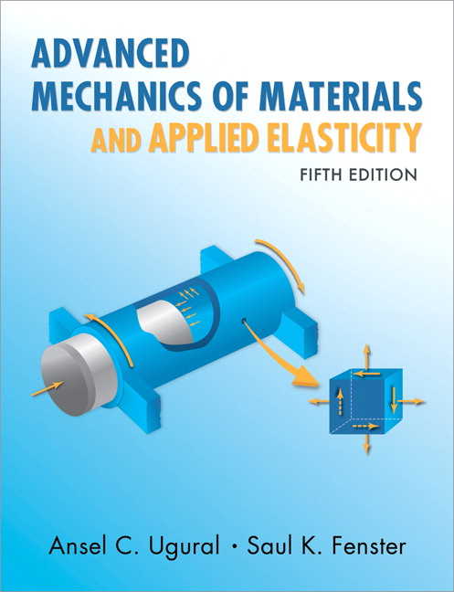
Advanced Mechanics
ANNOUNCE / BUSINESS
HW 01 (due Th, 01/16)
NEW STUFF
Why is stress a tensor?
What exactly is a tensor?
Stress transformation
Mohr’s circle (with example)

Slide 2
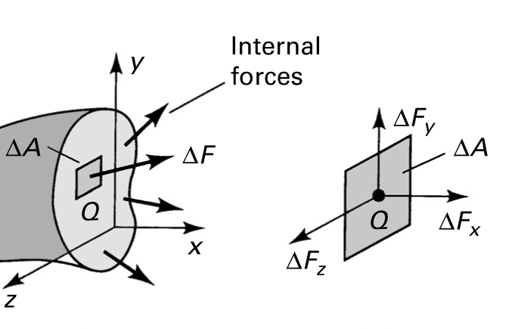
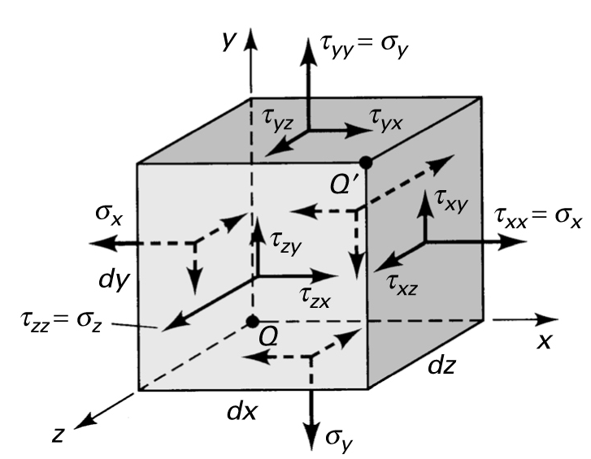
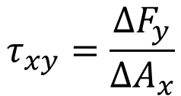
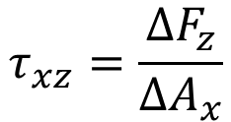
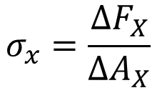
Stress
$$σ_{x}=\frac{{ΔF}_{X}}{{ΔA}_{X}}$$
$$τ_{xy}=\frac{{ΔF}_{y}}{{ΔA}_{x}}$$
$$τ_{xz}=\frac{{ΔF}_{z}}{{ΔA}_{x}}$$
Shear stress subscripts:
first refers to surface acting on
second to direction

Slide 3
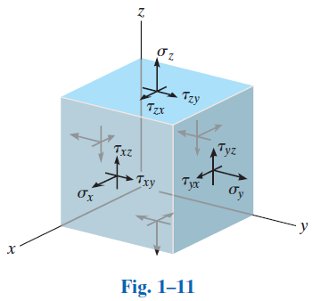
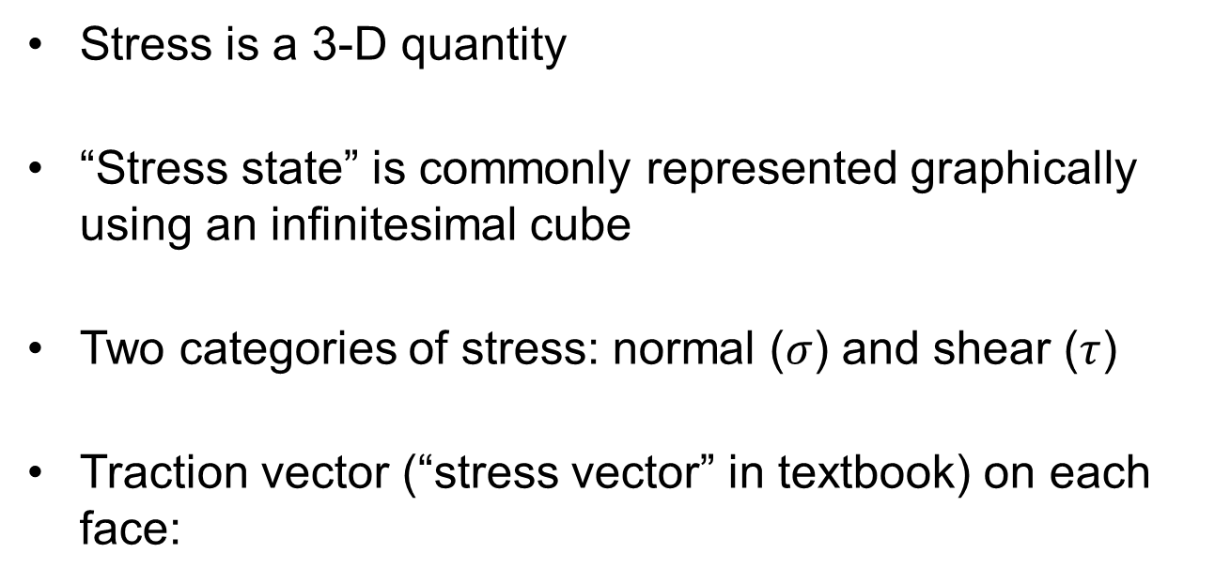
Stress
$$T_{z}$$
Stress is a 3-D quantity
“Stress state” is commonly represented graphically using an infinitesimal cube
Two categories of stress: normal ($σ$) and shear ($τ$)
Traction vector (“stress vector” in textbook) on each face:
$$T_{y}$$
$$T_{x}$$
$$T_{x}=σ_{x}n_{x}+τ_{xy}n_{y}+τ_{xz}n_{z}$$
$$T_{y}=τ_{yx}n_{x}+σ_{y}n_{y}+τ_{yz}n_{z}$$
$$T_{z}=τ_{zx}n_{x}+τ_{zy}n_{y}+σ_{z}n_{z}$$
Components depend on coordinate system (like vectors)

Slide 4
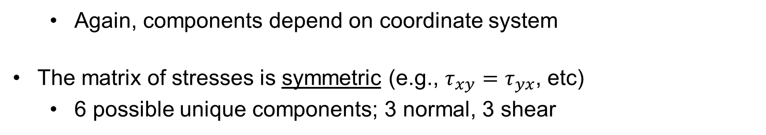
Stress Tensor
$$T_{x}=σ_{x}n_{x}+τ_{xy}n_{y}+τ_{xz}n_{z}$$
$$T_{y}=τ_{yx}n_{x}+σ_{y}n_{y}+τ_{yz}n_{z}$$
$$T_{z}=τ_{zx}n_{x}+τ_{zy}n_{y}+σ_{z}n_{z}$$
Stress is a second-order tensor (and can be represented as a matrix)
$$\left[σ_{ij}\right]=\left[\begin{matrix}σ_{x} & τ_{xy} & τ_{xz} \\ τ_{yx} & σ_{y} & τ_{yz} \\ τ_{zx} & τ_{zy} & σ_{z}\end{matrix}\right]$$
A vector is a first-order tensor
Again, components depend on coordinate system
The matrix of stresses is symmetric (e.g., $τ_{xy}=τ_{yx}$, etc)
6 possible unique components; 3 normal, 3 shear

Slide 5
Stress Tensor
$$\left[τ\right]=\left[\begin{matrix}τ_{xx} & τ_{xy} & τ_{xz} \\ τ_{yx} & τ_{yy} & τ_{yz} \\ τ_{zx} & τ_{zy} & τ_{zz}\end{matrix}\right]$$
=$\left[\begin{matrix}σ_{x} & τ_{xy} & τ_{xz} \\ τ_{yx} & σ_{y} & τ_{yz} \\ τ_{zx} & τ_{zy} & σ_{z}\end{matrix}\right]$
Indicial notation (Einstein summation convention) – Practice this!

Slide 6
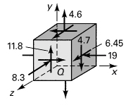
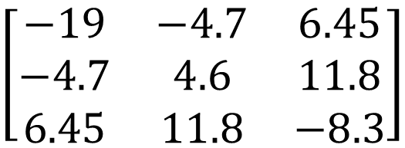
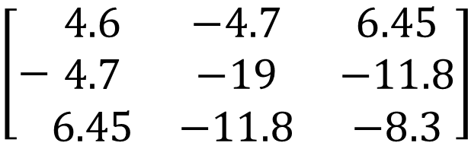
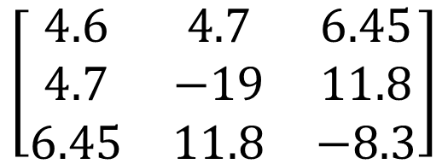
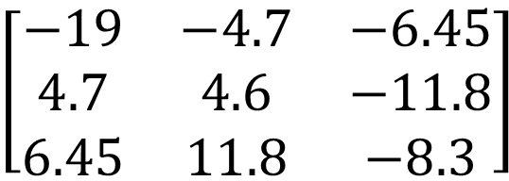
Quiz
Which stress tensor accurately describes the stress state shown?
$$\left[\begin{matrix}−19 & −4.7 & −6.45 \\ 4.7 & 4.6 & −11.8 \\ 6.45 & 11.8 & −8.3\end{matrix}\right]$$
A
$$\left[\begin{matrix}−19 & −4.7 & 6.45 \\ −4.7 & 4.6 & 11.8 \\ 6.45 & 11.8 & −8.3\end{matrix}\right]$$
B
$$\left[\begin{matrix}4.6 & 4.7 & 6.45 \\ 4.7 & −19 & 11.8 \\ 6.45 & 11.8 & −8.3\end{matrix}\right]$$
C
$$\left[−\begin{matrix}4.6 & −4.7 & 6.45 \\ 4.7 & −19 & −11.8 \\ 6.45 & −11.8 & −8.3\end{matrix}\right]$$
D
Notes:
Correct answer is B

Slide 7
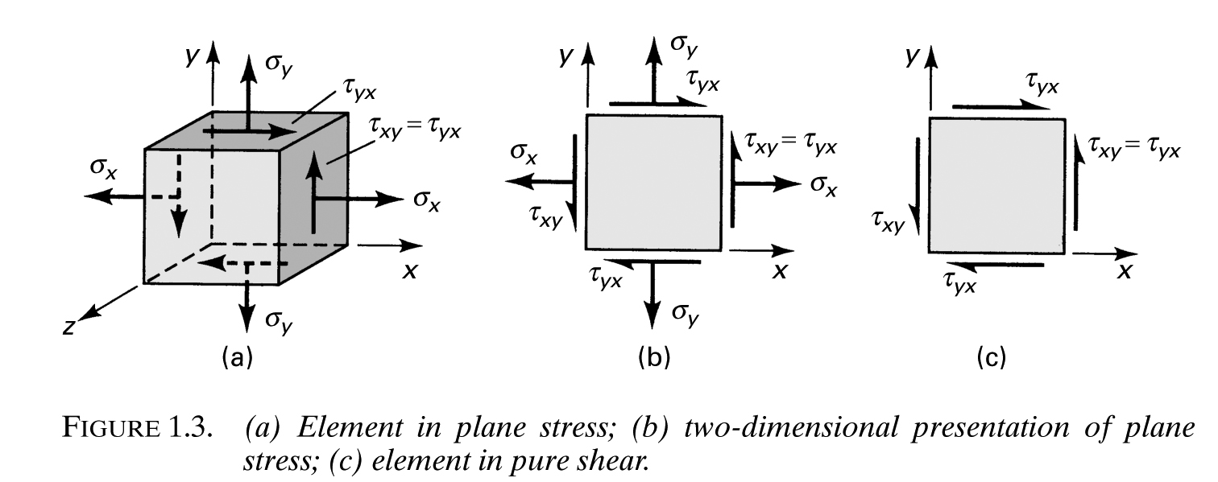
Stress – Special Cases
Uniaxial, biaxial stress (no shear -> principal stress state)
Triaxial stress (no shear; principal stress state)
when all 3 are equal: equitriaxial, spherical, hydrostatic
Plane stress (figures a and b)
Pure shear (figure c)
What does the stress tensor look like for each of the above?

Slide 8
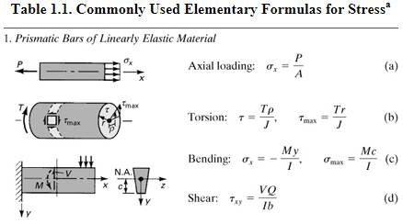
Stress Equations

Slide 9
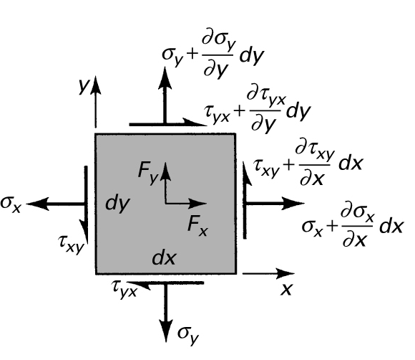
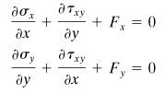
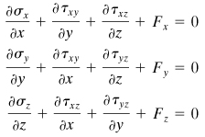
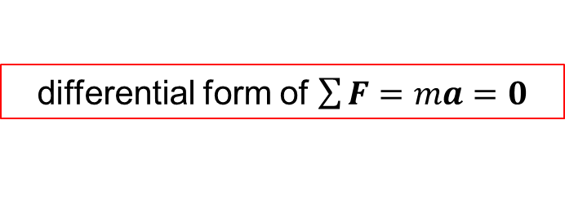
Variation of Stress Through Body
Equilibrium requires …
Eq’ns constrain stress variations and body forces
3-D Version
differential form of $\sum{F}=ma=0$
Notes:
Allow stress to vary over element, expressing increase in stress using Taylor Series expansion
Sum moments around corner to show equivalence of shear stresses within plane
Sum forces in each direction

Slide 10




Variation of Stress Through Body
Consider stress distribution in a hanging bar, loaded by its own weight
$$y$$
$$x$$
$$g$$
$$z$$
Notes:
Consider bar hanging under its own weight
Or consider example of cantilever bending: derivative of normal stress with respect to x (axis of beam) must be equal and opposite to derivative of transverse shear stress with respect to y (through beam thickness)

Slide 11
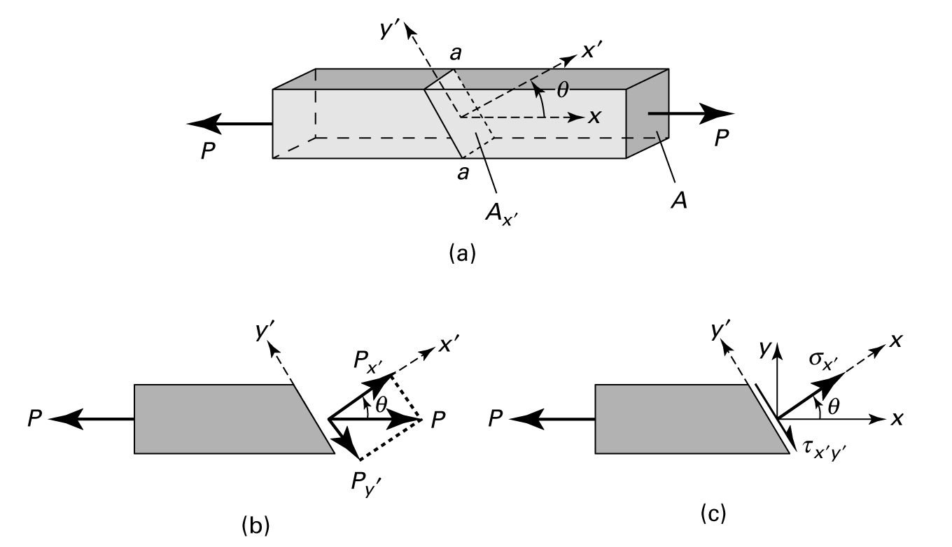
Stress on Inclined Sections
Notes:
Demonstrates that stress components change as we change the coord sys they refer to

Slide 12


Stress on Inclined Sections
Note
stress components change with coordinate system even though loading does not change
results are achieved by force equilibrium, not stress equilibrium (no such law)
Notes:
Demonstrates that stress components change as we change the coord sys they refer to

Slide 13
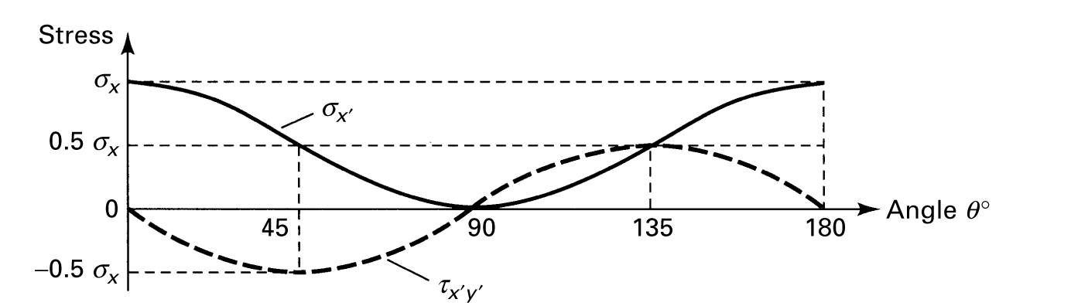
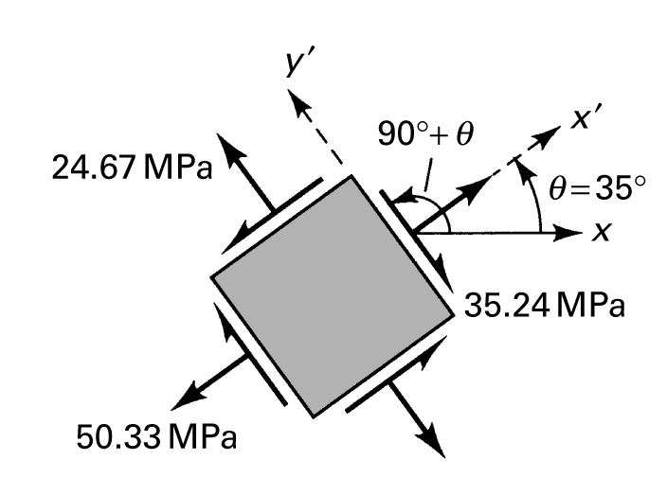
Stress on Inclined Sections
Prelude to stress transformation

Slide 14
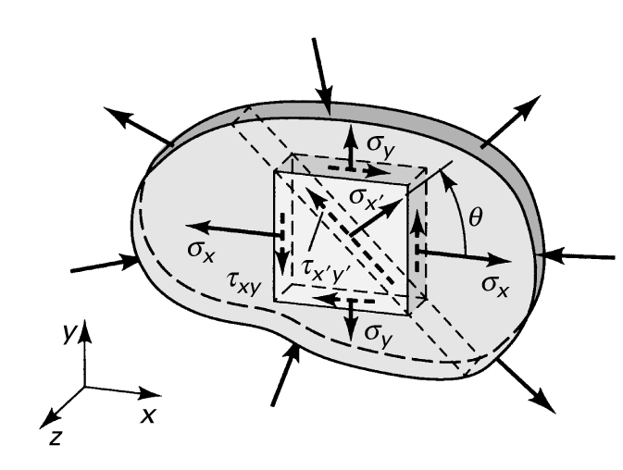
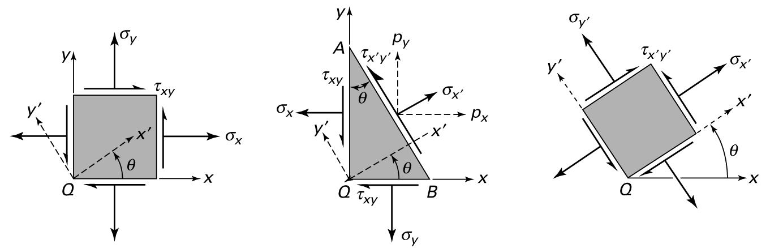
Stress Transformation – Plane Stress

Slide 15


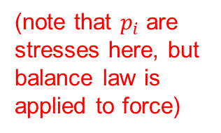
Stress Transformation – Plane Stress
(note that $p_{i}$ are stresses here, but balance law is applied to force)
Remember: Stress does not change during transformation, but its components change in the different coordinate system
Notes:
p, sigma, and tau are all stresses here, but equilibrium requires equality of force, so areas are also considered; hence, the first set of equations between p and sig and tau
These are the equations that define Mohr’s Circle

Slide 16
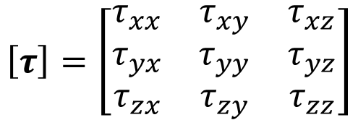
Invariants
It can be shown that
or … the sum of the normal stresses is invariant, i.e. it does not change with θ
also true in 3-D, as we will see
another way to say this: the trace of the stress tensor is invariant
$$\left[τ\right]=\left[\begin{matrix}τ_{xx} & τ_{xy} & τ_{xz} \\ τ_{yx} & τ_{yy} & τ_{yz} \\ τ_{zx} & τ_{zy} & τ_{zz}\end{matrix}\right]$$
Familiar invariant example: recall that the length of a vector (its magnitude) does not change when it is represented in a new coordinate system. We thus say that vector magnitude is invariant.

Slide 17
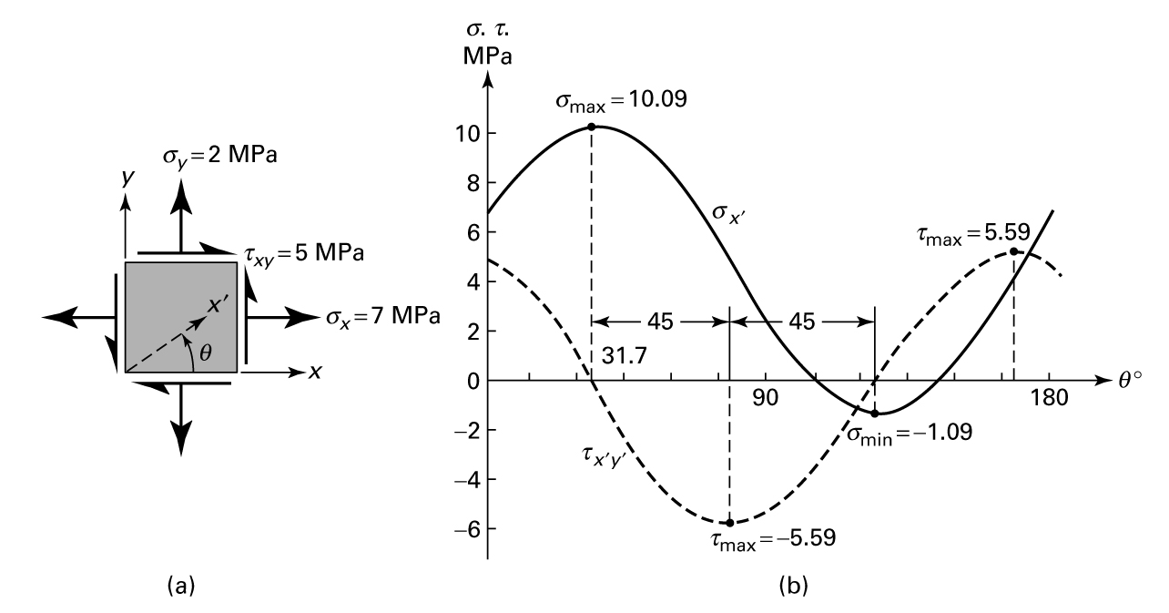
Principal Stress
Normal and shear stresses are continuously variable with theta (even though the stress state is not changing)
Normal stress is at extreme when shear stress is zero. This stress is called the principal stress (and is invariant).
Principal stress and max shear stress always occur 45 degrees apart

Slide 18


Principal Stress
Derive equations for principal stresses by taking the derivative of the stress transformation equations and setting equal to zero. This gives the angle at which extreme values occur.
Two solutions for θ_{p}! → 2 principal stresses (in 2-D)
Plugging into stress transformation equations gives
(subscripts 1 and 2 used to denote principal stresses)

Slide 19

Maximum Shear Stress
Principal stresses, i.e. eigenvalues of the (2D) stress tensor
We can similarly find the equation for max shear stress

Slide 20
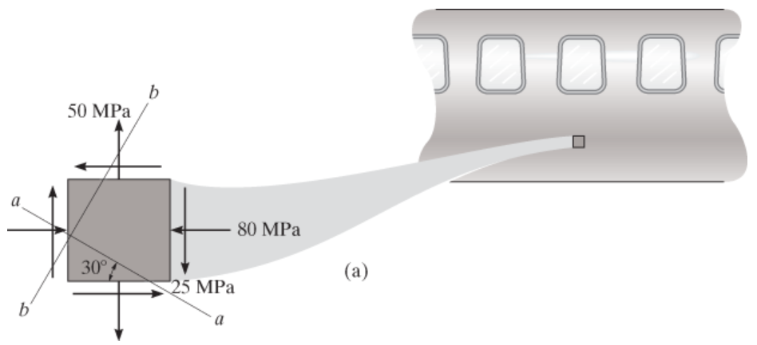
Mohr’s Circle
Alternative to memorizing long equations … Mohr’s Circle
Example: The state of plane stress at a point on the surface of the airplane fuselage is represented on the element oriented as shown. Represent the state of stress at the same point on an element that is oriented 30° clockwise from this position.
Notes:
My conventions for Mohr’s Circle:
Shear stress axis positive downward – preserves rotation direction (CCW still positive)
Sign of shear stress in stress state is defined by considering direction of rotation stress causes on element, again using right hand rule

